Slide 1
Get Your Deal Done

Slide 2
Why Auction?
Auctions are the proven way to achieve maximum value for your property in the shortest possible timeframe.
Notes:
In cooperation with

Slide 3
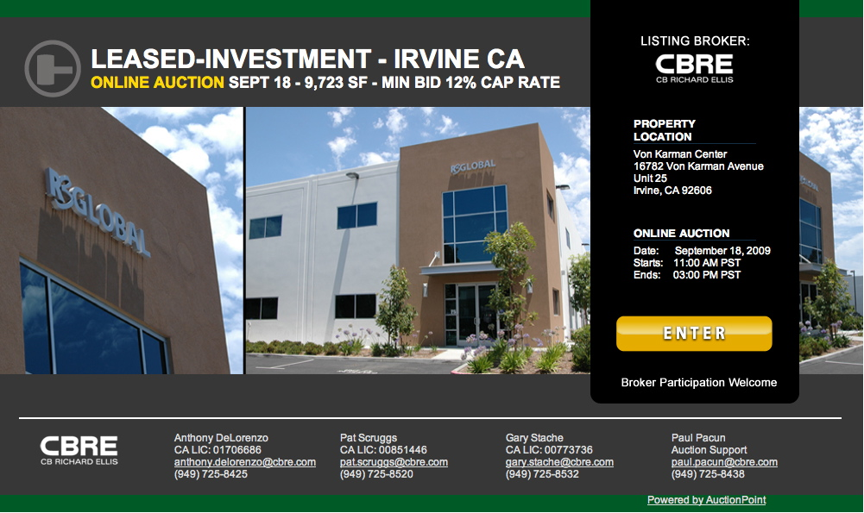
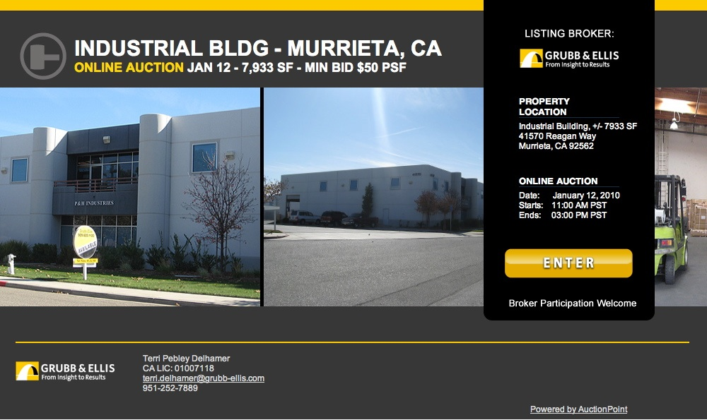
Why AuctionPoint?
AuctionPoint is the online auction platform designed specifically for the disposition of real estate.
The AuctionPoint platform creates property-specific auction websites that your broker markets to the best potential buyer pool.

Slide 4
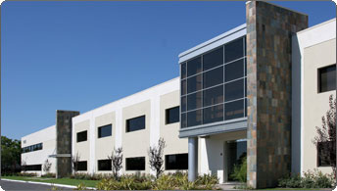
Proven Results
Founded by two commercial developers who were holding significant inventory in late 2007. 13 properties had been on the market for an average of 27 months with no activity. After exhausting traditional marketing strategies, the developers created the broker-run online auction platform.
The Results?
13 out of the 13 available properties SOLD
4 sold prior to auction, just by motivating buyers off of the sidelines
6 sold at auction after only 5 weeks of marketing

Slide 5
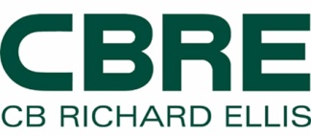
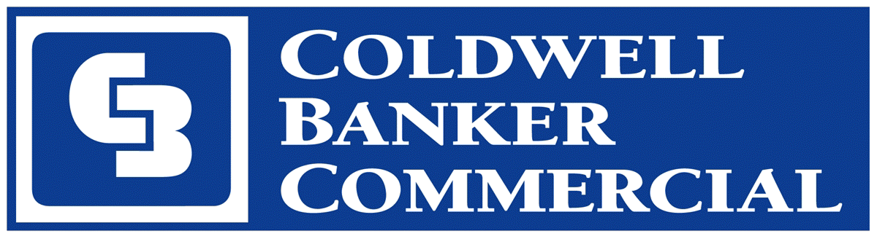
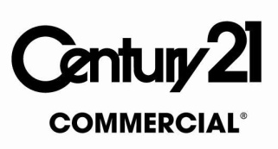
Proven Results
Brokers from leading firms across the country have adopted the platform:

Slide 6
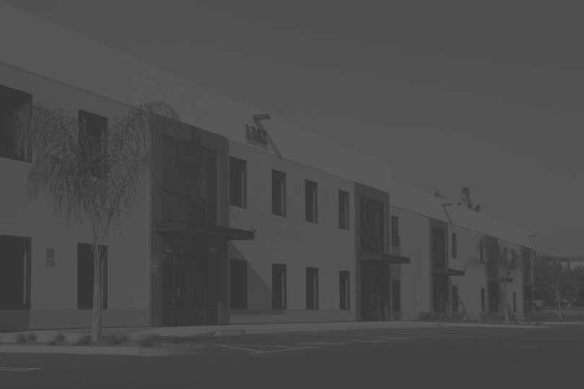
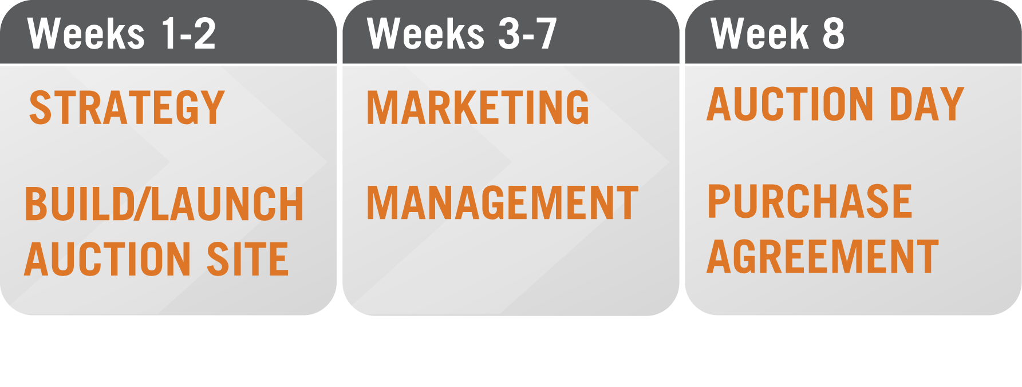
How It Works
From start-to-finish, and the process can take 8 weeks or less

Slide 7
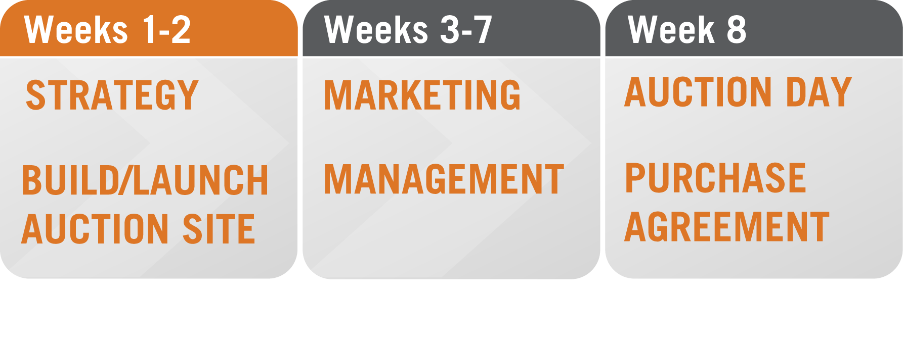
Strategy
Determine minimum bid pricing to attract the largest possible pool of buyers, key marketing tactics and effective auction management.
Build/Launch Auction Site
Your broker posts property information, pictures and due diligence materials to the AuctionPoint Powered auction website.
Your broker creates compelling auction marketing collateral based on samples from successful auctions.
Your auction website is built, you approve it and it’s launched.

Slide 8
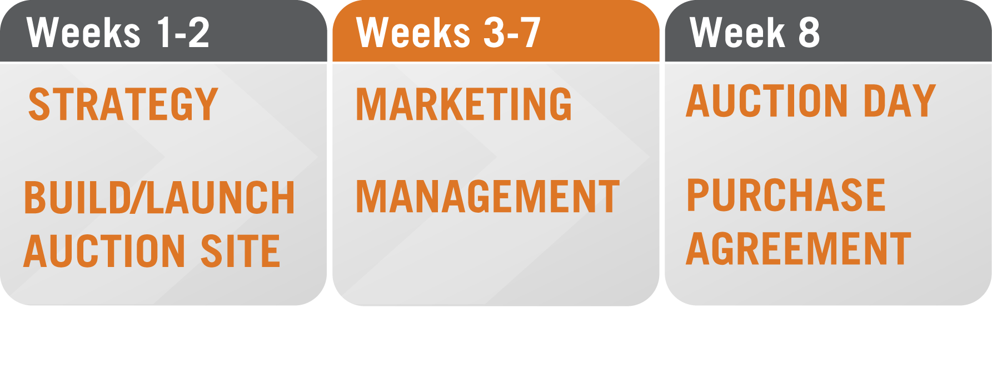
Marketing
Your broker markets the auction to the best potential buyers.
Your broker can produce auction website traffic reports, optimizing all marketing efforts.
Management
Your broker to monitors the auction and communicates with all registered users and qualified bidders.

Slide 9
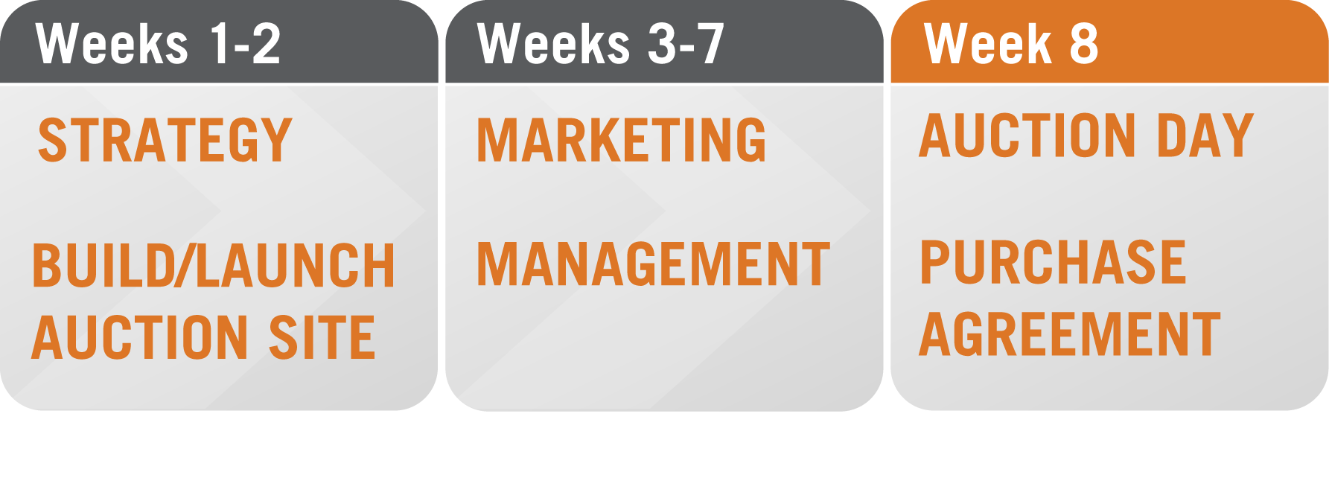
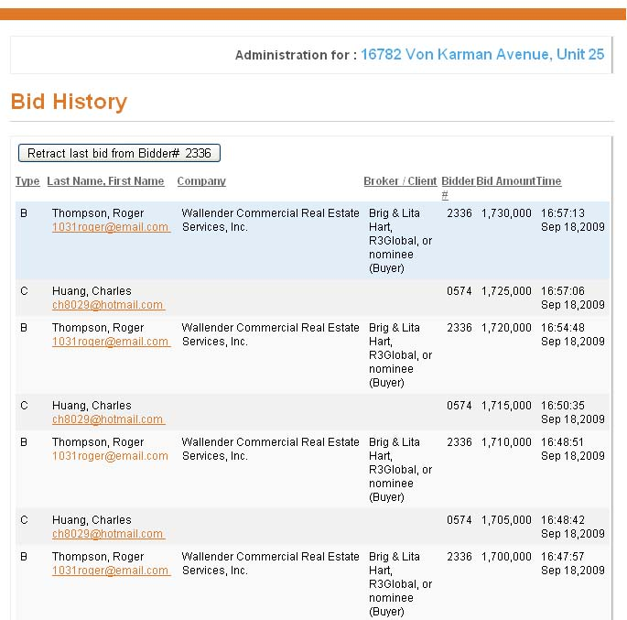
Auction Day
Your broker reaches out to all qualified bidders to keep them excited and motivated to bid.
You and your broker have full access to the auction “back room” and can observe who is signed in and bidding.
Purchase Agreement
The winning bidder signs the purchase agreement within two business days of the close of auction.

Slide 10
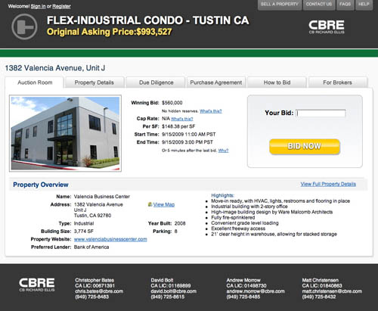
Case Study #1 – Leased Investment Auction
16782 Von Karman, Unit 25, Irvine, California
Closed escrow: October 30, 2009
Winning bid: $1,730,000
Auction participants: 97
Qualified bidders: 21
Bids received: 87
This property was successfully auctioned after just 5 weeks of marketing by the brokers. Prior to the auction program the property sat on the market for 24 months with no activity, despite traditional marketing efforts.

Slide 11
Case Study #2 – Industrial Condo Auction
1382 Valencia Avenue, Unit J, Tustin California
Closed escrow: November 16, 2009
Winning bid: $560,000
Auction participants: 113
Qualified bidders: 33
Bids received: 30
Brokers marketed this auction for just five weeks before getting a signed purchase agreement. The property had been marketed using traditional methods for 30 months prior to the auction program with no activity.

Slide 12
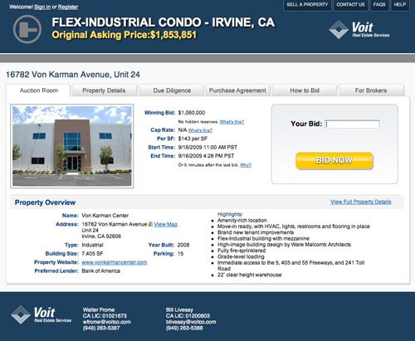
Case Study #3 – Industrial Condo Auction
16782 Von Karman, Unit 24, Irvine California
Closed escrow: November 16, 2009
Winning bid: $1,060,000
Auction participants: 82
Qualified bidders: 10
Bids received: 60
This property was successfully auctioned after just 5 weeks of marketing by the brokers. Prior to the auction program the property sat on the market for 24 months with no activity, despite traditional marketing efforts.

Slide 13
Getting Started
Sign-Up
$395 Set-up Fee
Broker License Agreement
Owner’s Authorization Agreement
$1,200 refundable Auction Deposit
Close of Escrow
AuctionPoint collects a Buyer’s Premium from the winning bidder
AuctionPoint refunds the $1,200 Auction Deposit
Contact Swoboda Hospitality Specialists today to start your auction! 602-468-3548 or e-mail info@shs.com

